Slide 1
KM-Project Presentation
Juyee Myeong
Juyeon Nam

Slide 2
Content
Idea
KB-Schema
Implemented instances
Queries – simple, Intermediate, Advanced

Slide 3
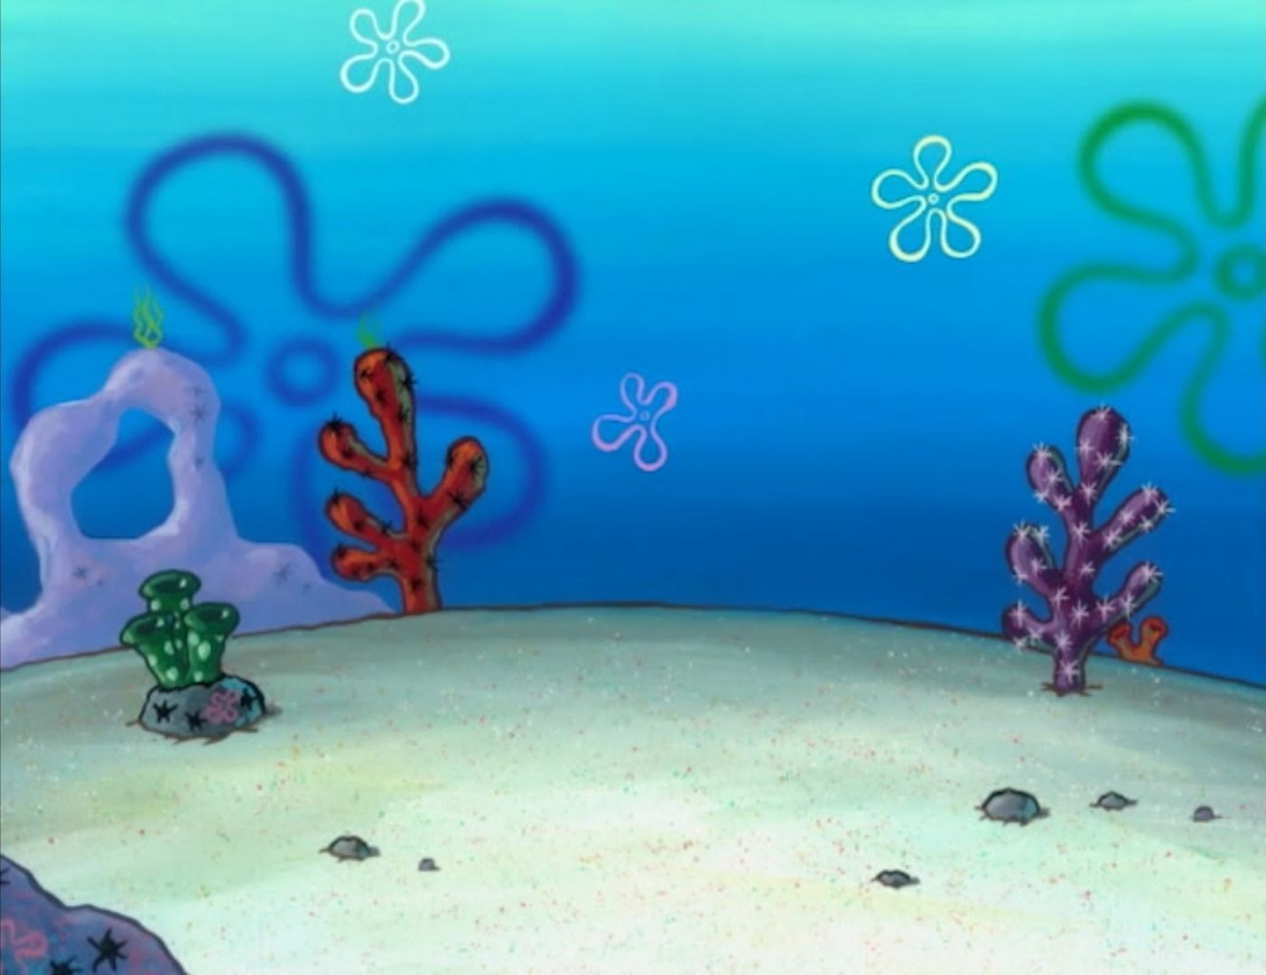
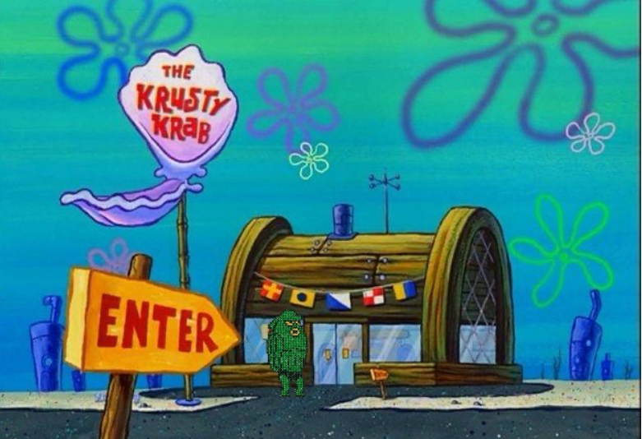
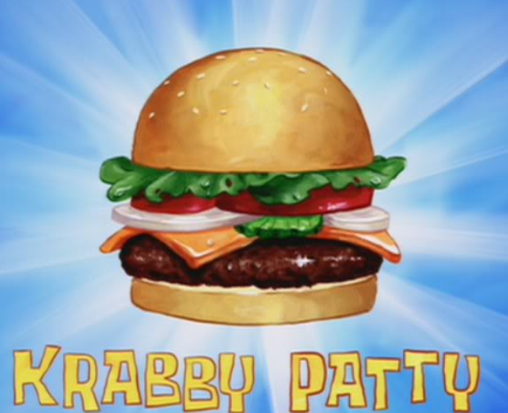
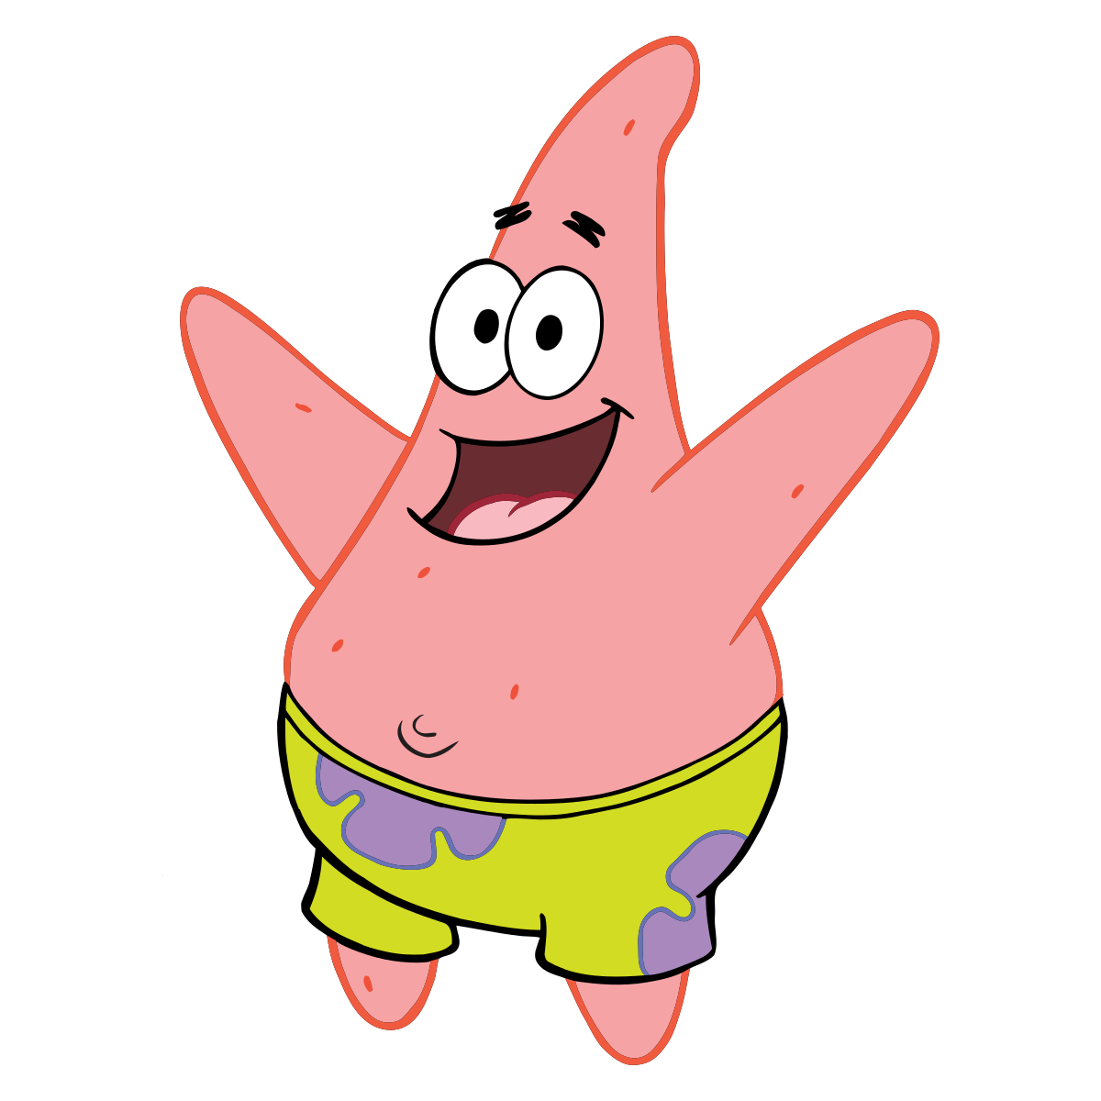
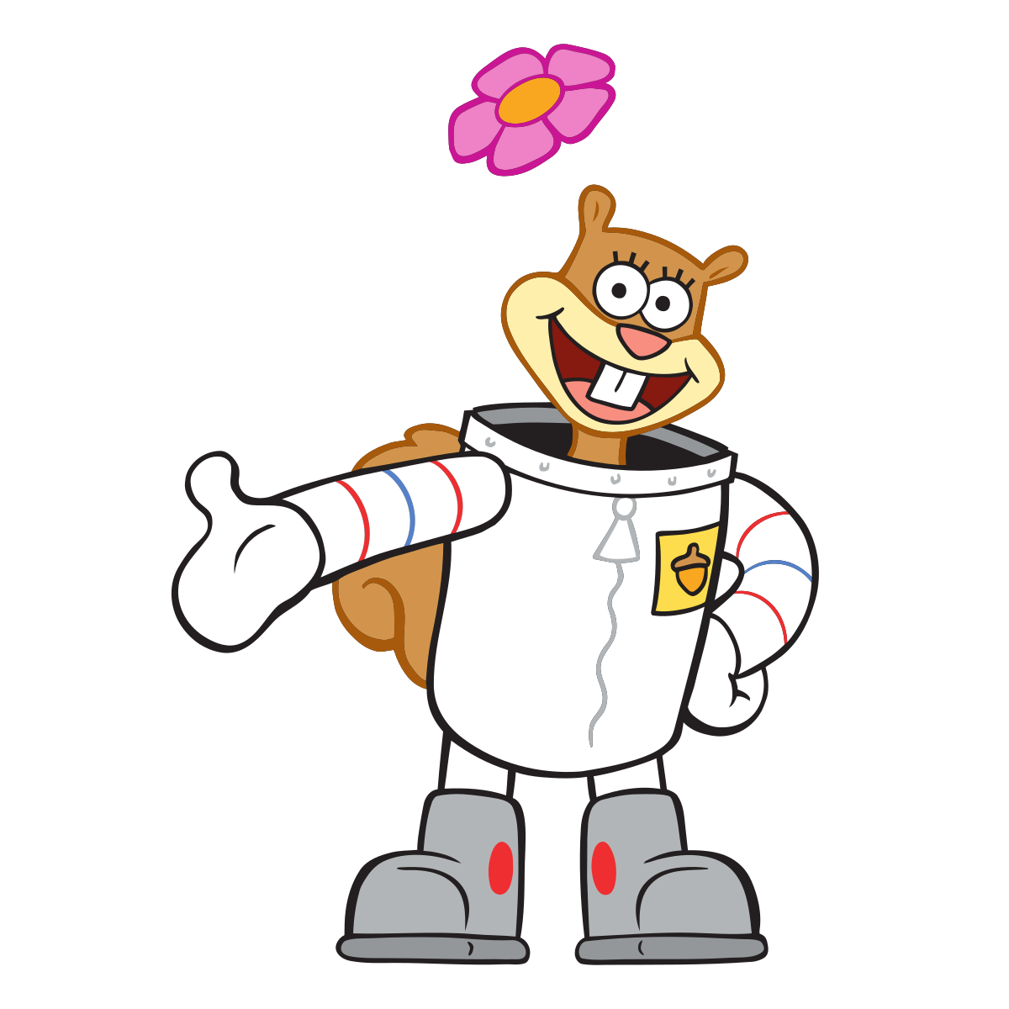
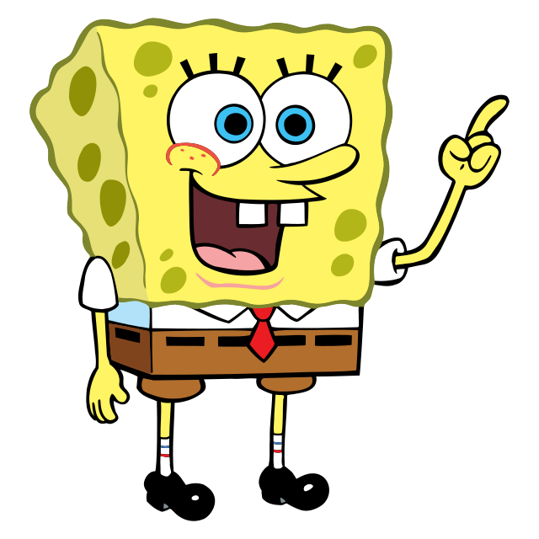
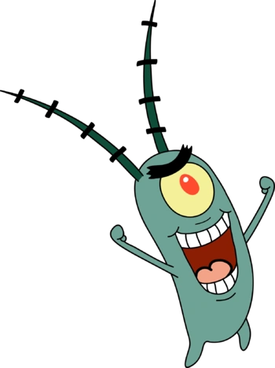
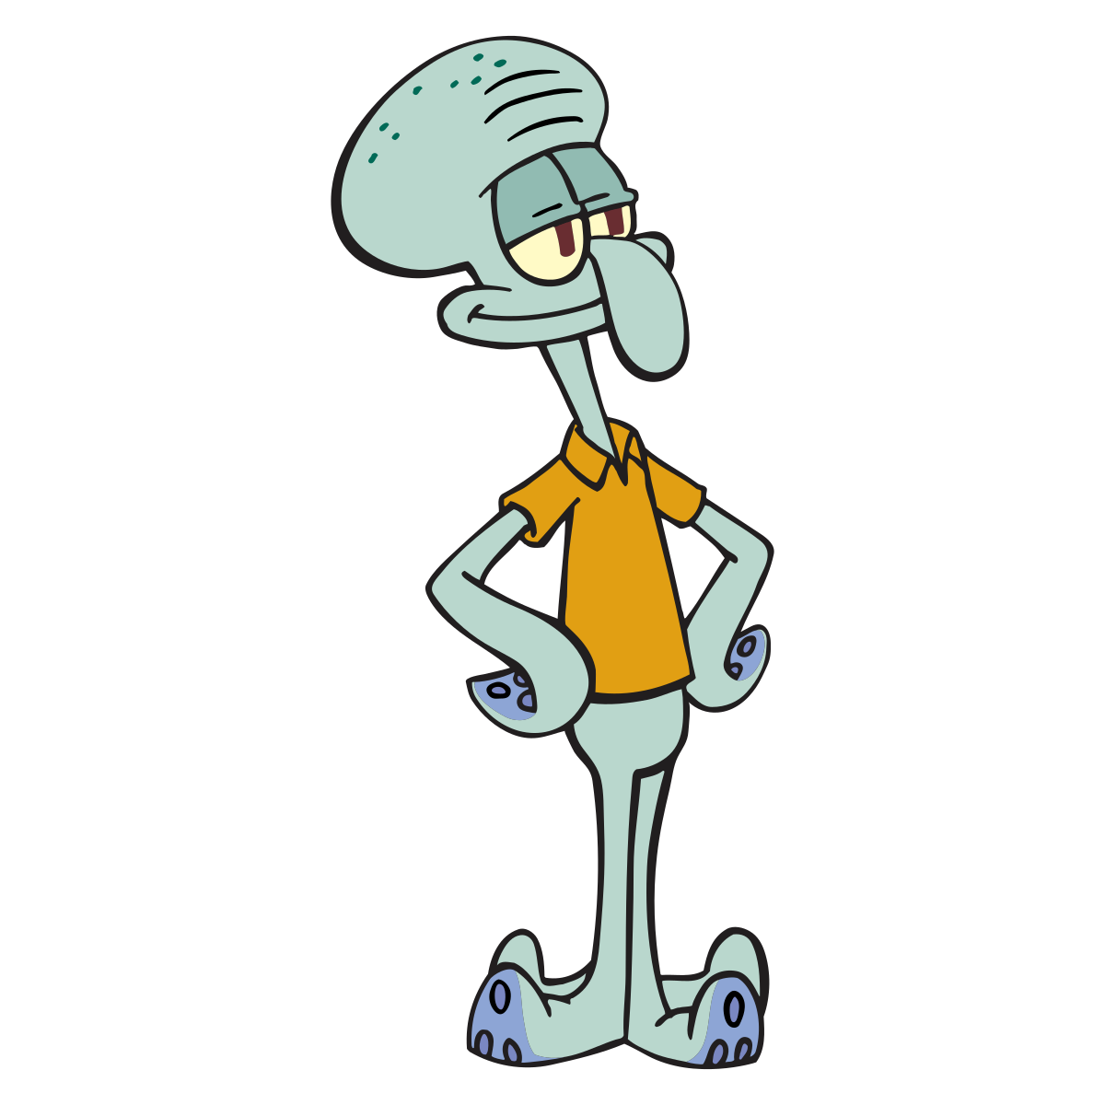
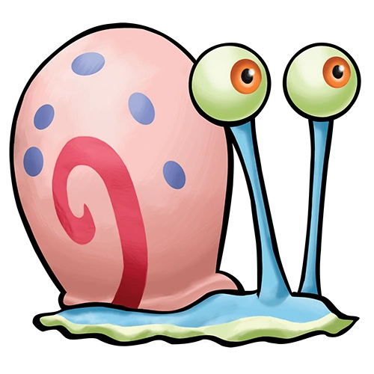
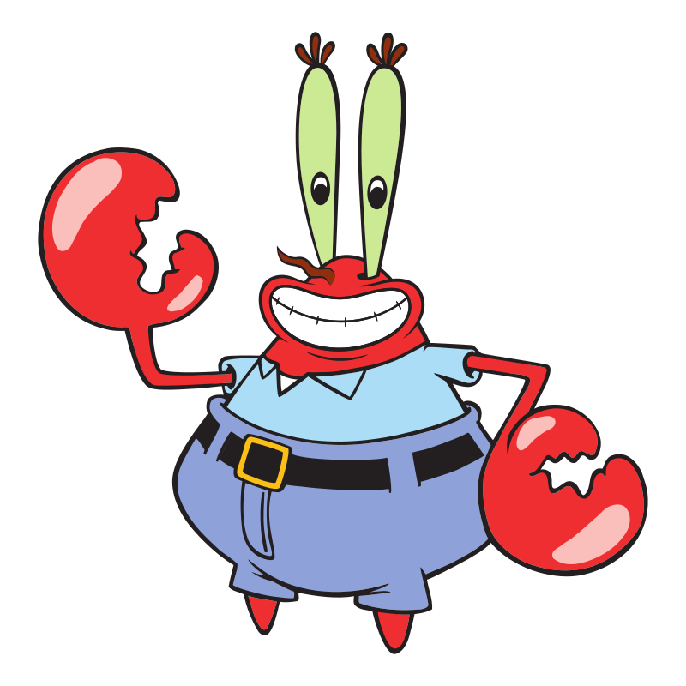
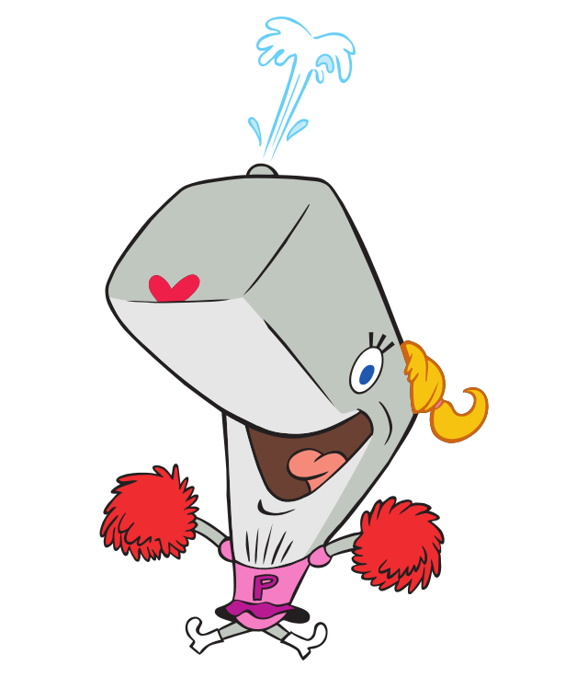
Vikini City
Patrick Star
Sandy Cheeks
SpongeBob
Plankton
Squidward
Gary
Mr. Krab
Pearl

Slide 4
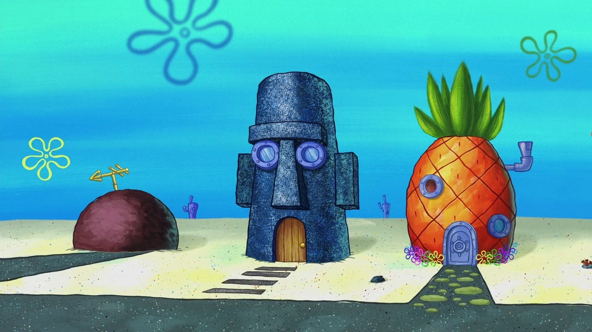
1. Idea
Information & Relationship
KM about Krusty Krab – Krabby Patty – Residents of Vikini City relationship
Krusty Krab(Restaurant)
- Who owns Krusty Krab
- Who works at Krusty Krab
- Who is going to be hired at Krusty Krab
Krabby Patty
- Who likes or dislikes it
Residents of Vikini City
- Neighbor / Friend & Enemy / Family
- How much is Resident1’s salary
- What is Resident2’s personality like
- Can Resident3 eat Krabby-Patty every day

Slide 5
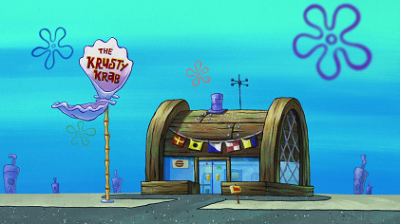
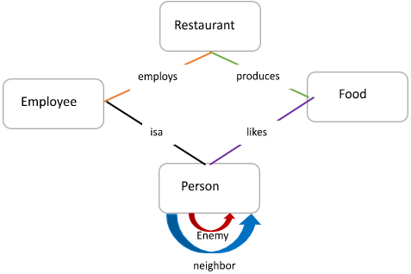
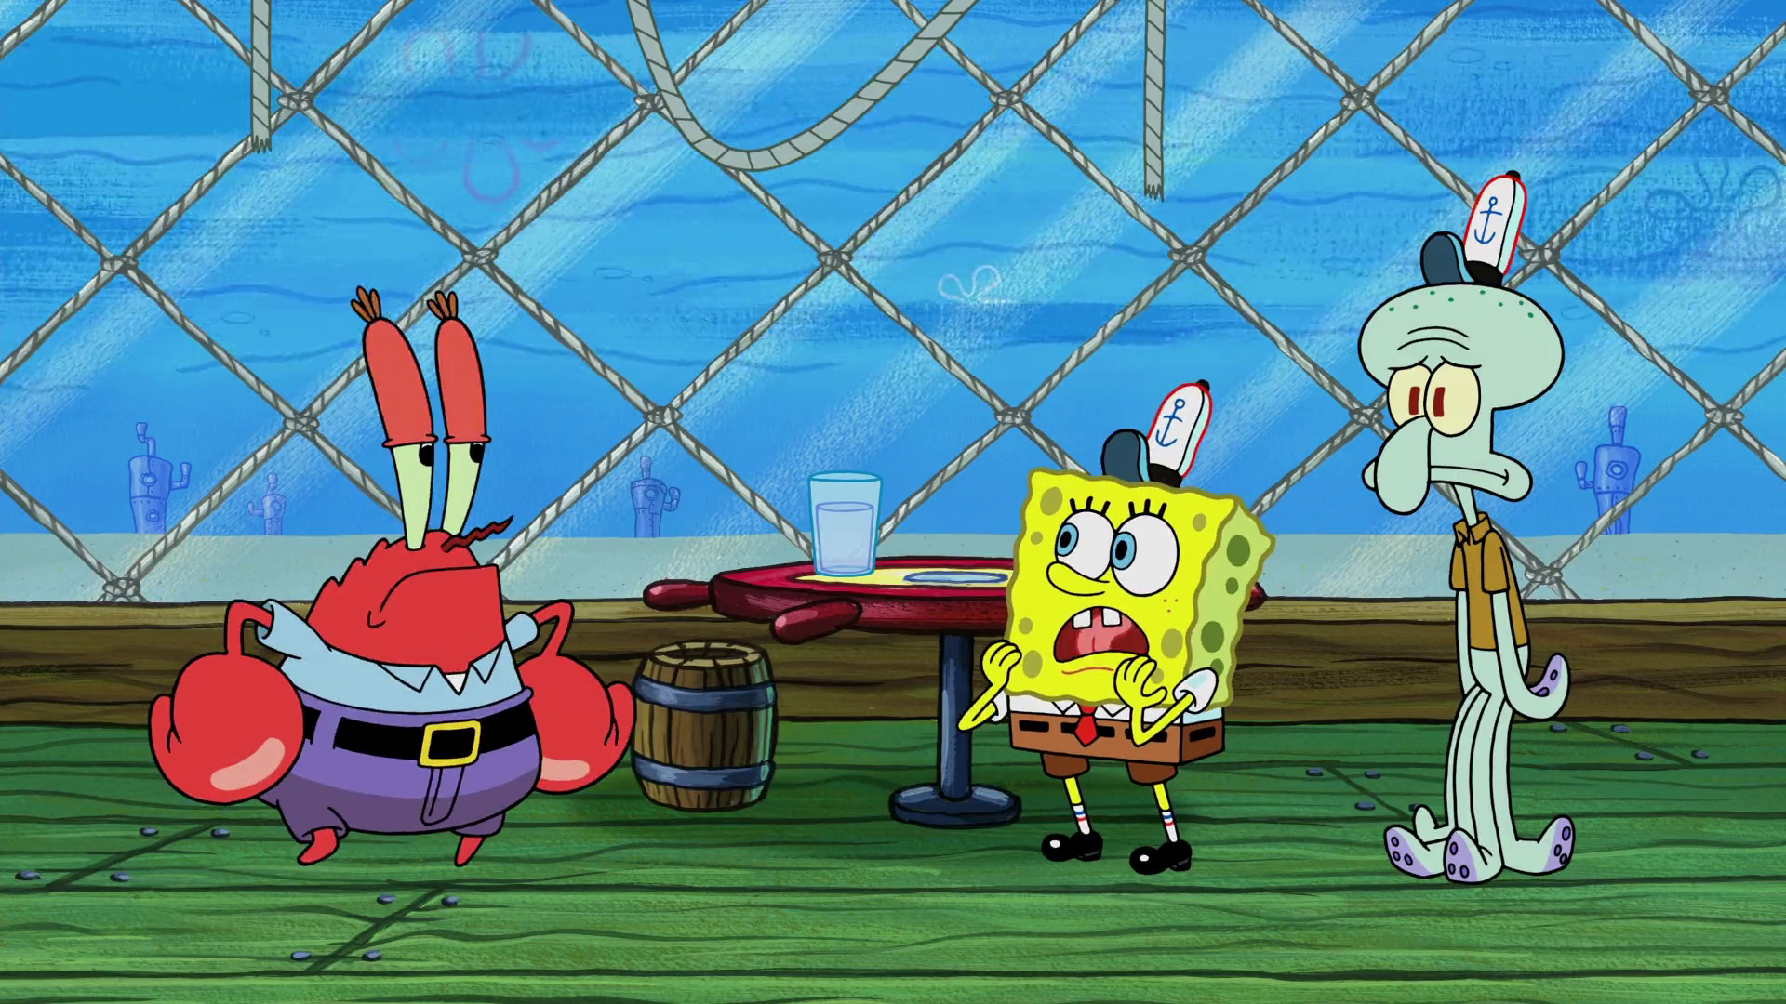
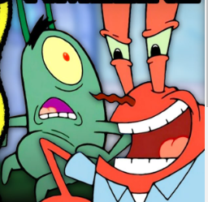
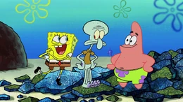
2. Schema

Slide 6
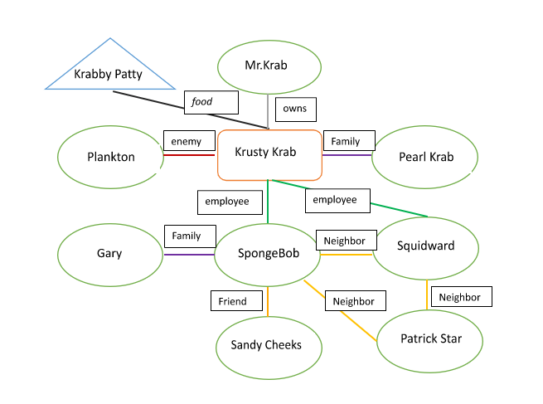
3. 1 Implemented Instance - Simple

Slide 7
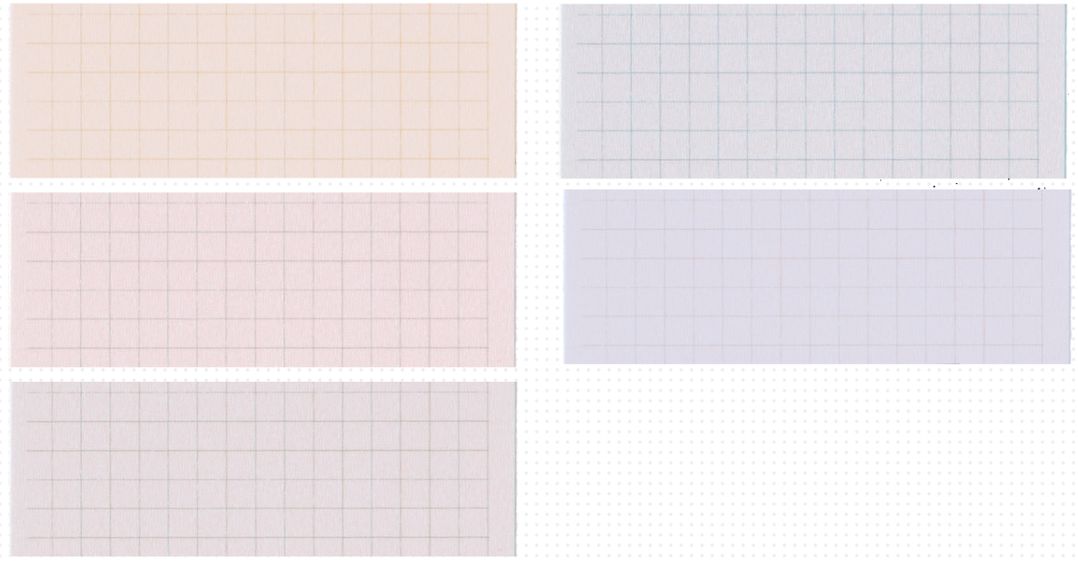
3. 1 Implemented Instance - Intermediate & Advanced
Personality
positive
clean
curious
friendly
dumb
Appearance
Outfit: Shirt, Squarepants, Shoes
Yellow
Big tooth
Smile
Personality
positive
clean
curious
friendly
Appearance
Outfit: Spacesuit, Shoes
Brown
tooth
Smile
SpongeBob
Sandy Cheeks
Personality
positive
curious
friendly
dumb
Appearance
Outfit: Flowerpants
Pink
Smile
Personality
positive
clean
curious
friendly
dumb
Appearance
Outfit: TShirt, Skirt, Shoes
Blue
tooth
Smile
Patrick Star
Pearl
Personality
clean
Appearance
Outfit: Shirt,
Blue
Squidward

Slide 8
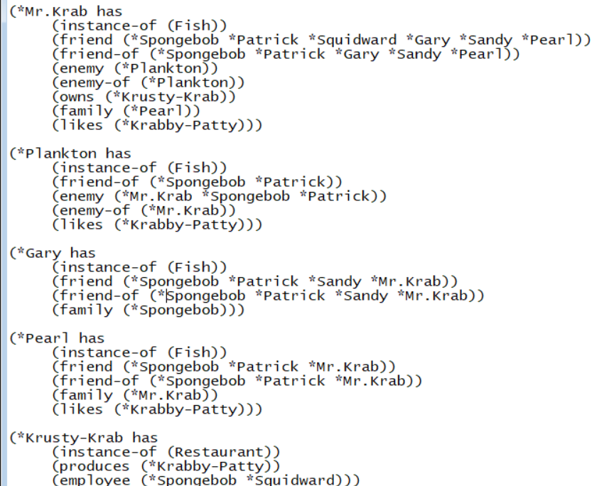
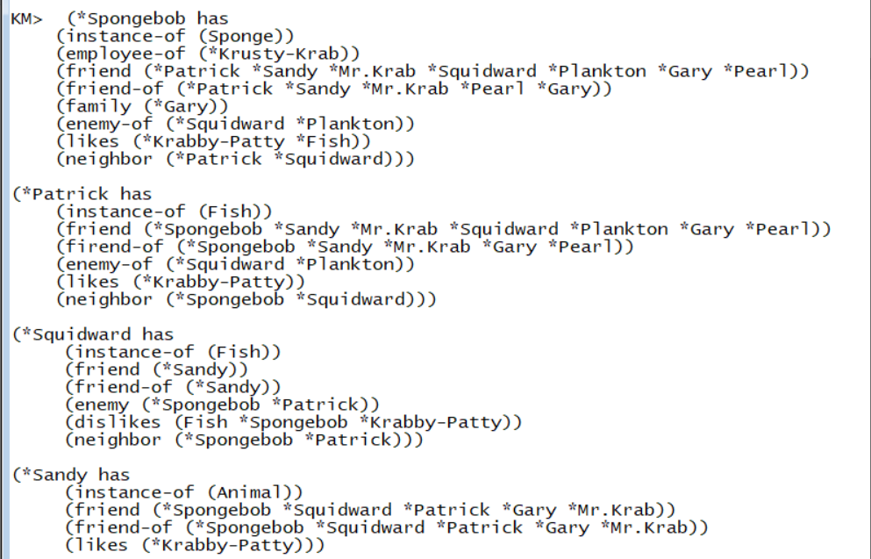
3.2 Part of KM code

Slide 9
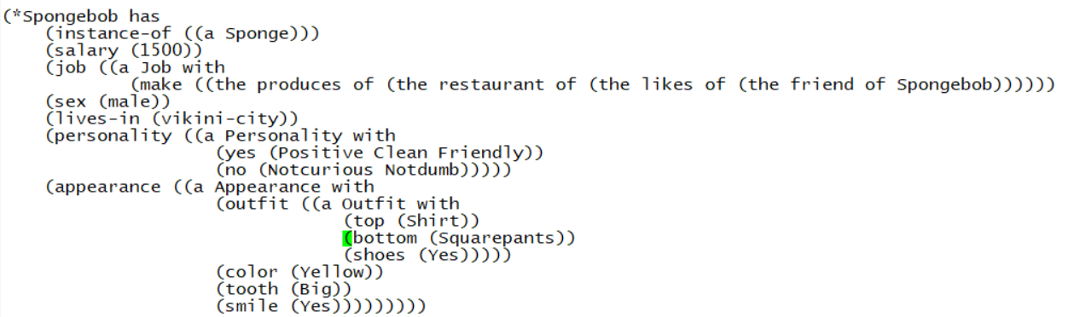
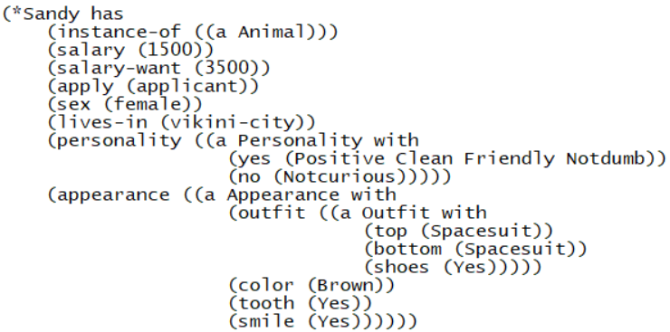
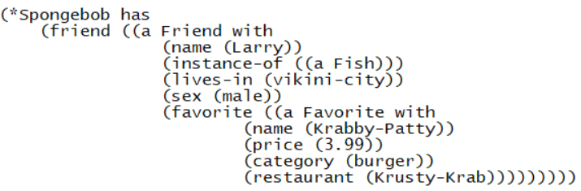
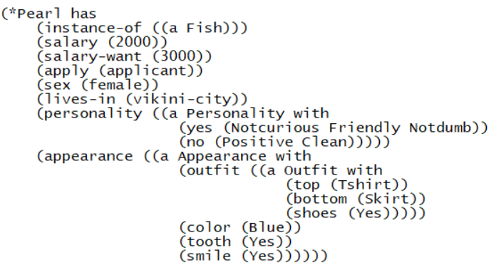
3.2 Part of KM code

Slide 10
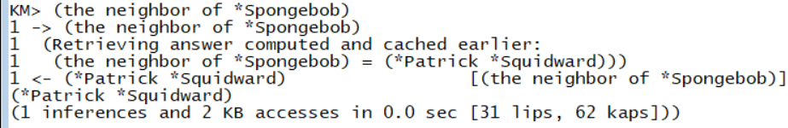
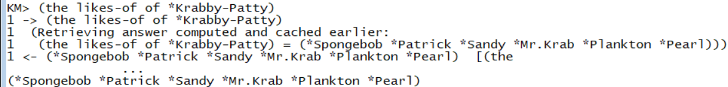
4-1. Simple Queries - 1, 2
Find the neighbor of SpongeBob
Who likes Krabby Patty?

Slide 11
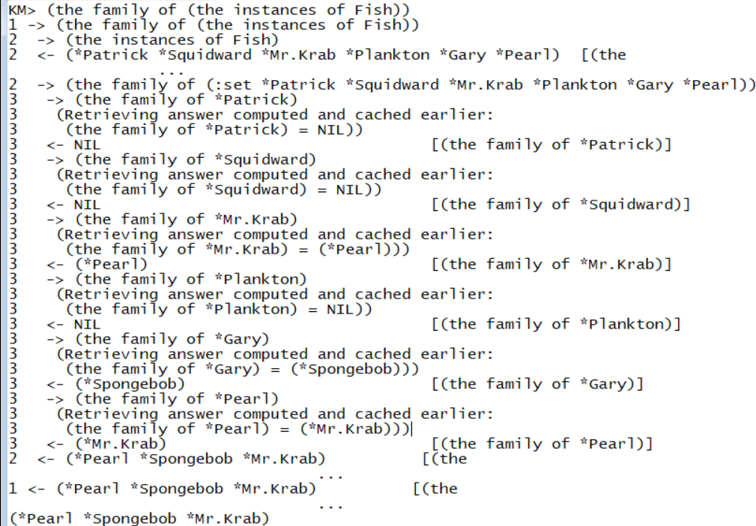
4.1 Simple Queries - 3
Who has family?

Slide 12
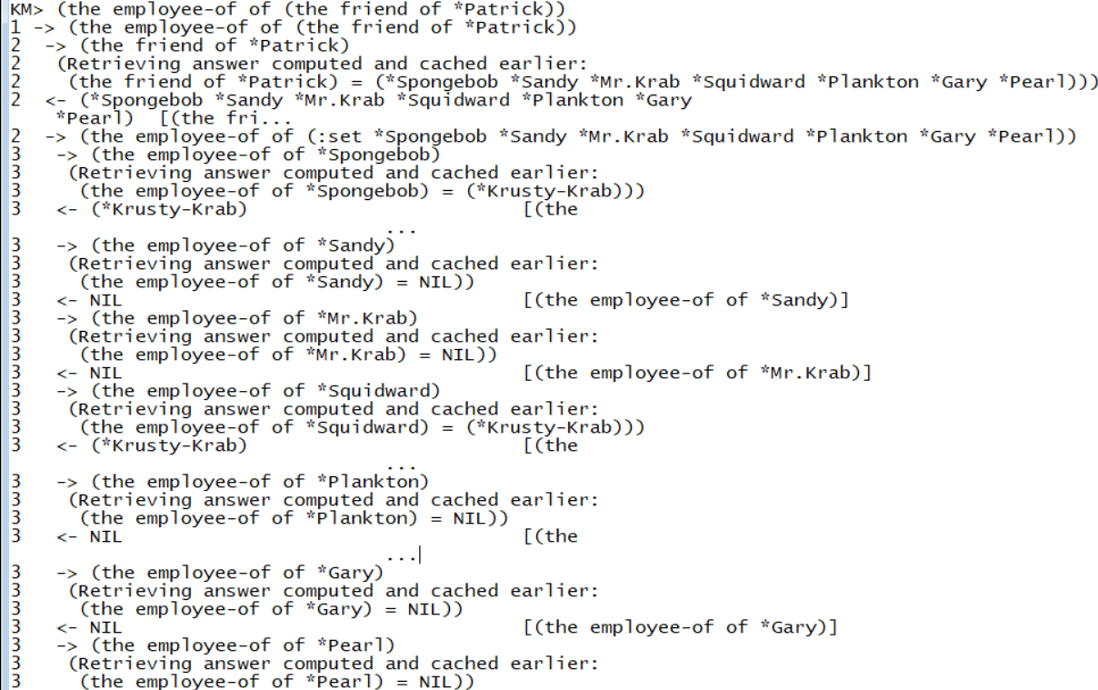
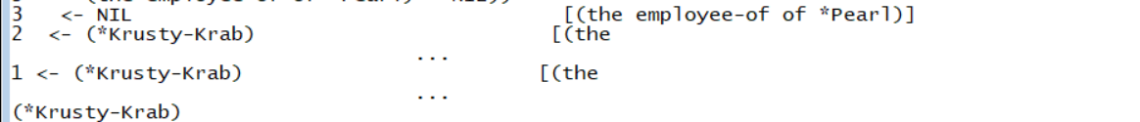
4.1 Simple queries - 4
Who employs the friend of Patrick?

Slide 13
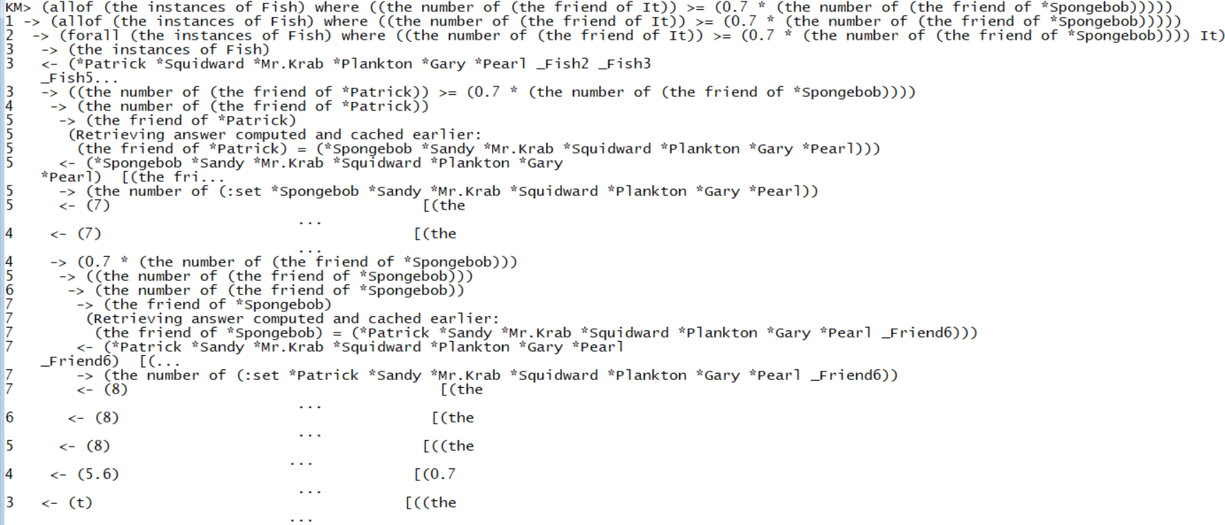
4.2 Intermediate queries - 1
Which fish thinks of itself as a famous fish in VIKINI city?
(Find the fish which has friends 0.7 times or more the number of SpongeBob's friends)

Slide 14
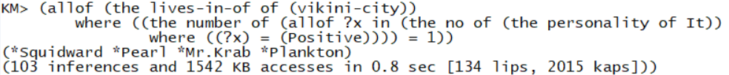
4.2 Intermediate queries - 2
Which character has negative personality?

Slide 15
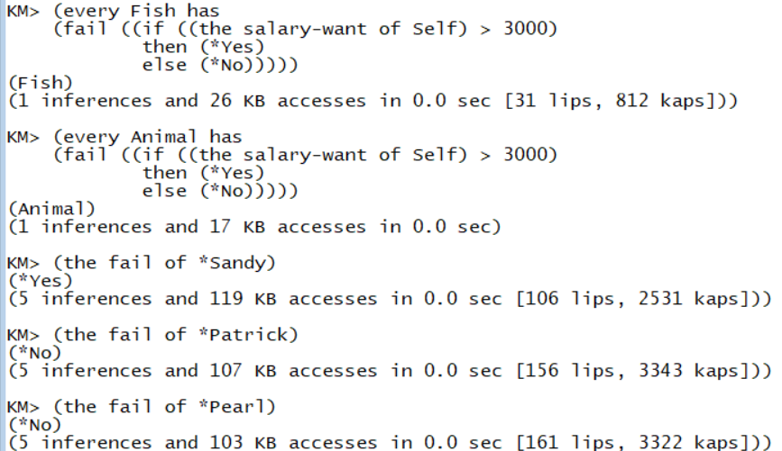
4.3 Advanced queries - 1(1)
Mr.Krab is trying to hire an employee.
First, he considers firing if the desired wage of the applicant exceeds $3000.

Slide 16
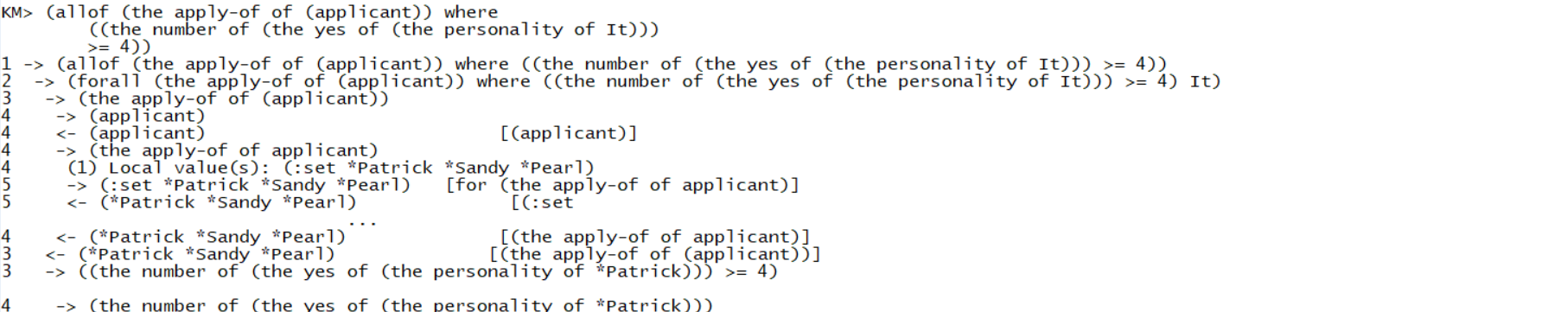
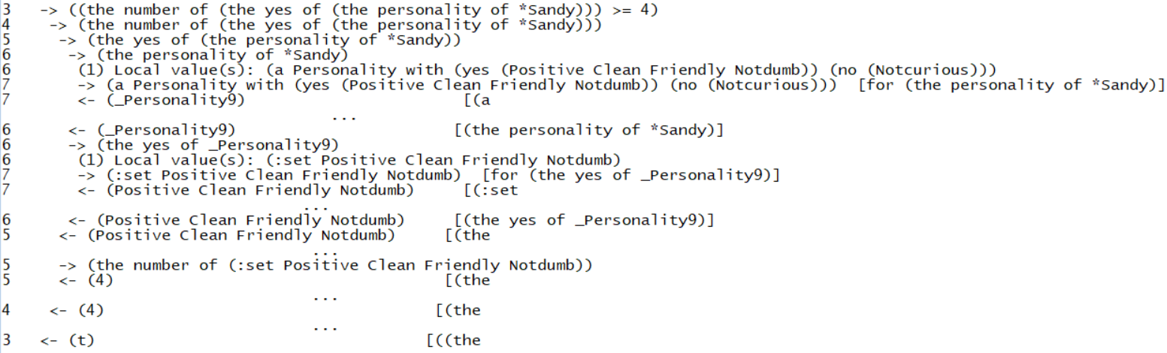
4.3 Advanced queries - 1(2)
Sandy applied again after contracting wage negotiation with Mr.Krab.
Mr. Krab wants to hire positive, neat, not curious, friendly, and not dumb applicant.
If more than four conditions are met, it will be hired.

Slide 17
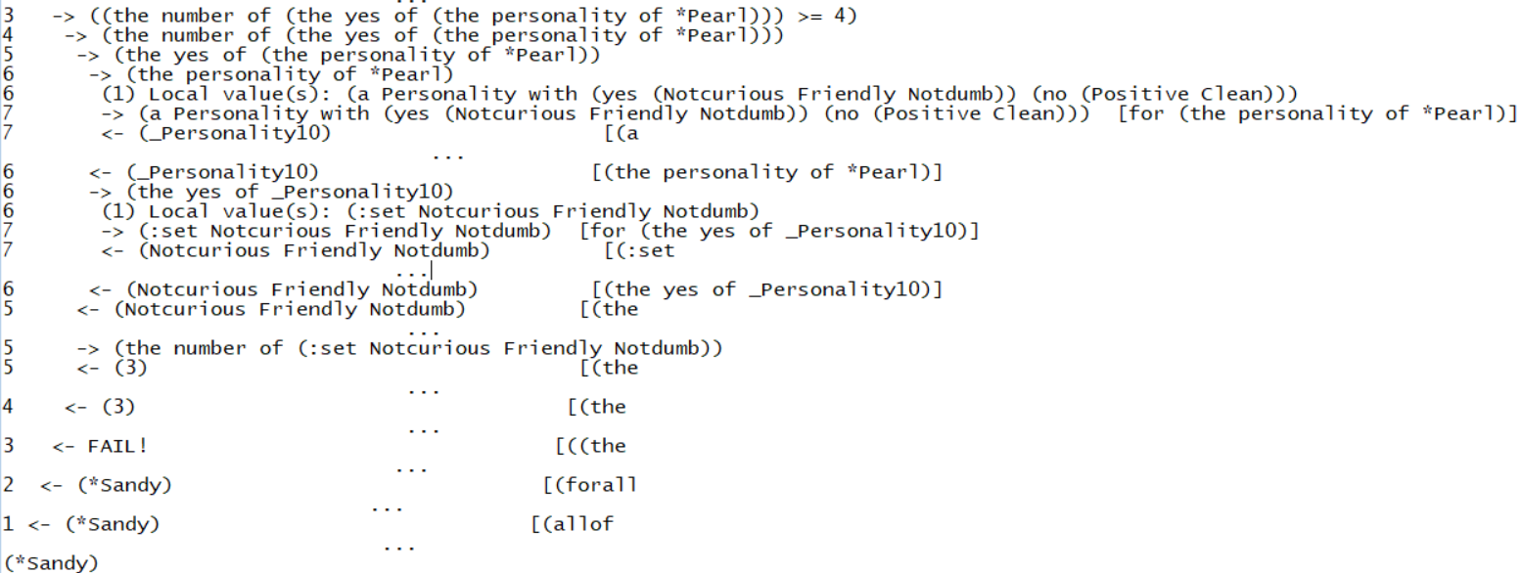
4.3 Advanced queries - 1(2)

Slide 18
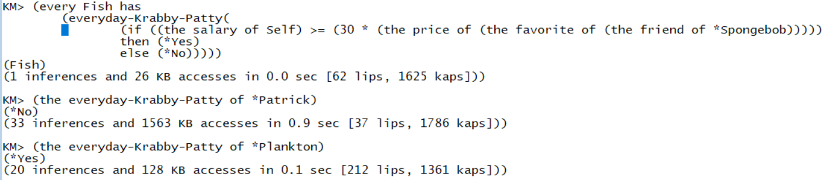
4.3 Advanced queries - 2
Can Plankton and Patrick buy one krabby patty per a day?

Slide 19
5. Extensibility
We only covered a small number of characters of Spongebob SquarePants and dealt with a very small part of the relationship.
We can do some similar queries using other characteristic of characters (ex. Appearance)
New characters and restaurants can easily be adopted.

Slide 20
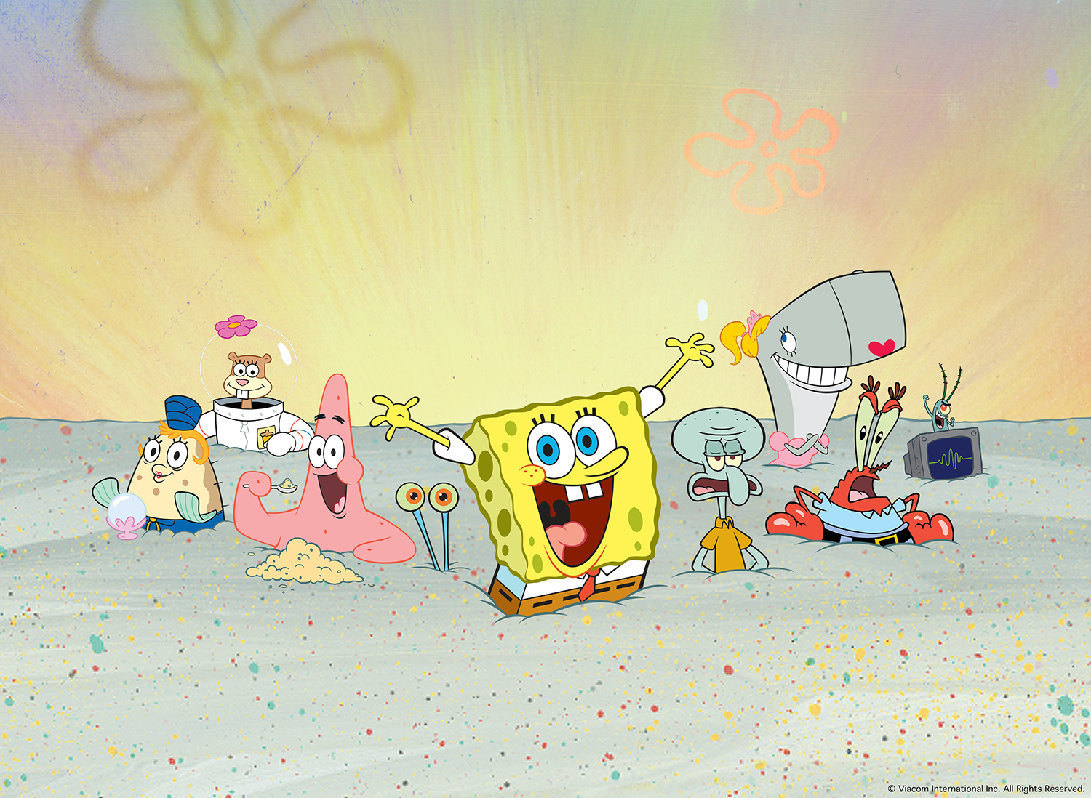
Thank you!
Thank you for listening

